Slide 1
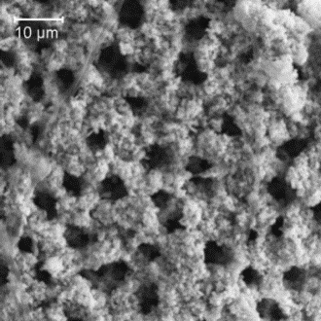
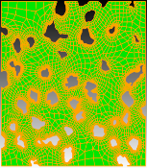
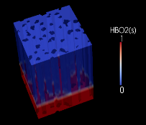

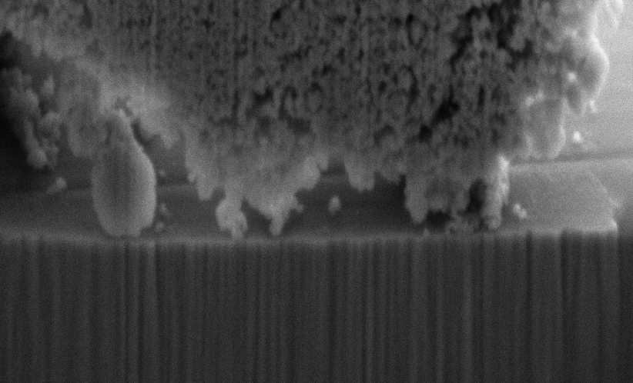


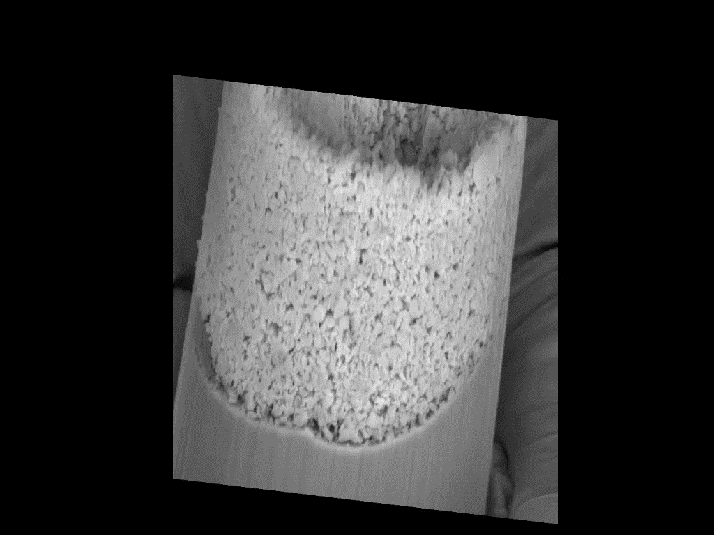
Characterization and Mitigation of CRUD Growth at PWR Fuel Cladding Conditions
Michael Short
February 16, 2016
TMS-2016, Nashville, TN

Slide 2

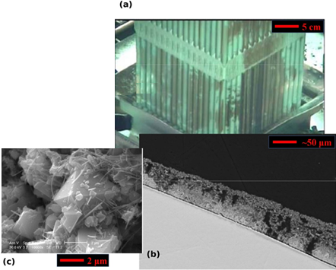
What the Hell Is CRUD?
Chalk River Unidentified Deposits: Corrosion deposits on fuel rods
Corrosion products deposit as CRUD on fuel rods
To hot leg
CRUD constituent phases
CRUD cross section showing typical structure
From cold leg
Short, M. P.,et al. MRS-B 39(1):71-77 (2014)

Slide 3
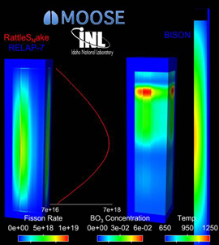
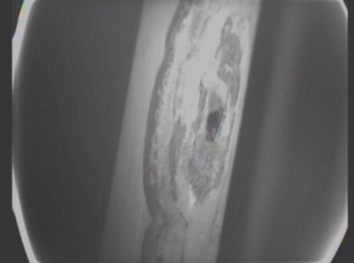
Who Cares About CRUD?
Chalk River Unidentified Deposits: Causes operational problems like:
Axial downward power shift
CRUD-induced localized corrosion
Core Height
“Leaker” fuel failures
CRUD induced power shift
BO₃ Concentration
Power
Image: D. Gaston et al. Ann. Nucl. Ener., doi: 10.1016/j.anucene.2014.09.060 (2014)
Image: D. Wells. EPRI Summer P-TAC Meeting (2013)

Slide 4
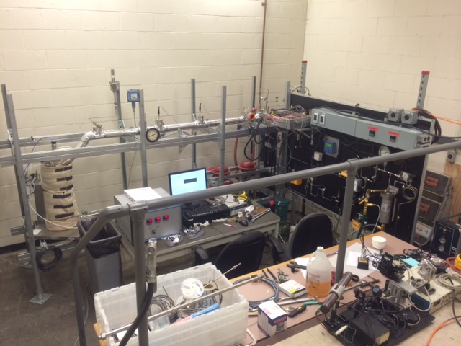
Overview of the MIT IHTFP* Loop
*Internally Heated Testloop for PWRs

Slide 5
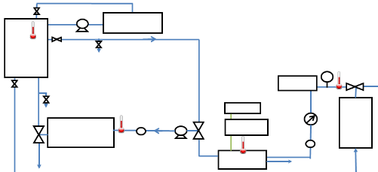
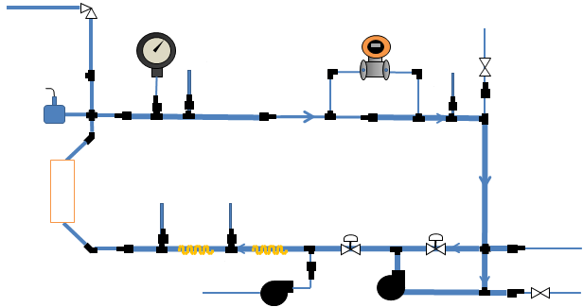
Overview of the MIT IHTFP Loop
Auxiliary Loop
Controls chemistry
Room temperature, slightly pressurized
Auxiliary Loop
Circulation Loop
At actual PWR conditions
Where the CRUD actually grows
Circulation Loop

Slide 6
Main Circulation Loop
Pressure Control
Flow Control
1
Temperature Control
3
2
Increased by pressurizing pump
Measured by pressure transmitter and gauges
Set by back-pressure regulator
Increased by autoclave heating rod and pre-heater
Measured by thermocouples in autoclave and on the loop
Increased by circulation pump
Measured by differential pressure transmitter
Moderated by control valve
1
1
1
2
2
2
3
3
To Vent
Differential Pressure Sensor
Vacuum Terminal
1 Inch tubing
Pressure Relief Valve
3/4 Inch tubing
1/2 Inch tubing
1/4 Inch tubing
Pressure switch
Pressure Gauge
Thermocouple
Control Valve
Autoclave
Control Valve
To Auxiliary Loop
Pre-heater
Fill Terminal
From Water Tank
Fill Terminal
Pressurizing Pump
Circulation Pump

Slide 7
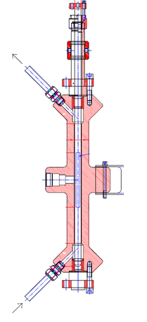
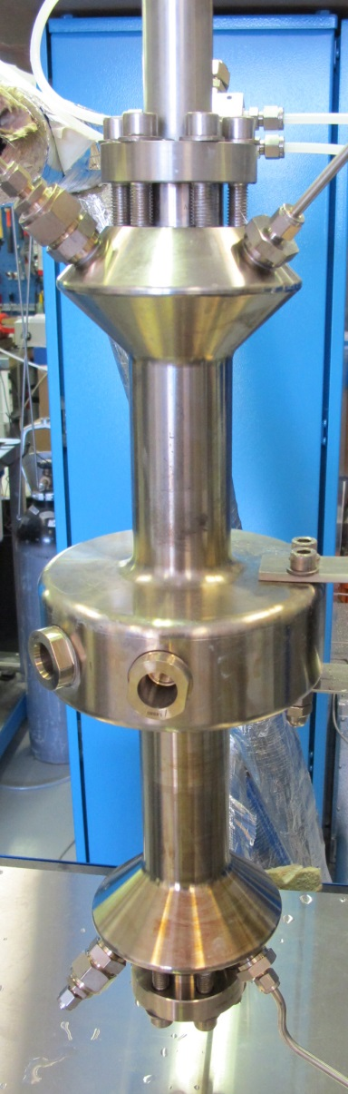
Where the Magic Happens: The Autoclave
Water out
Actual Autoclave
Sapphire
Windows
Water in

Slide 8
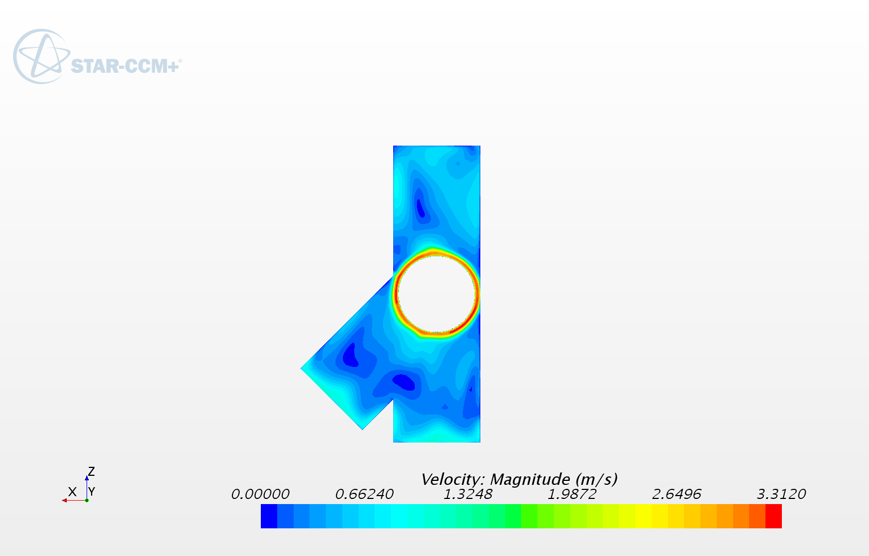
CFD Shows Minimal Flow Disturbance
CFD analysis courtesy of Akshay Dave, Victor Petrov, Annalisa Manera of U. Michigan
Flow remains relatively uniform around heating rod

Slide 9
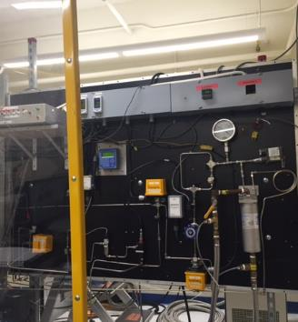
Auxiliary Chemistry Control Loop
Small pump
Ion Exchange Resin Container
Water Tank
Pressure Gauge
Pressure transmitter
Drain
Cooler
pressure
regulator
Measurement equipment
pH, Dissolved O2, Conductivity
Small pump
Drain
From Circulation Loop
To Circulation Loop
Pressurizing pump
Valve
Flow Sensor
Temperature Probe

Slide 10
Comparison of IHTFP to a PWR
 | PWR | First Sample
Pressure | 15.5 MPa | 15.5 MPa
Temperature | 287-324°C | 320°C
Reynolds Number | 5·10⁵ | 1.62·10⁵
Mass flux | 3500 kg/m²s | 1920 kg/m²s
Fe₃O₄, NiO | 13-116 ppb | 20,000 ppb

Slide 11
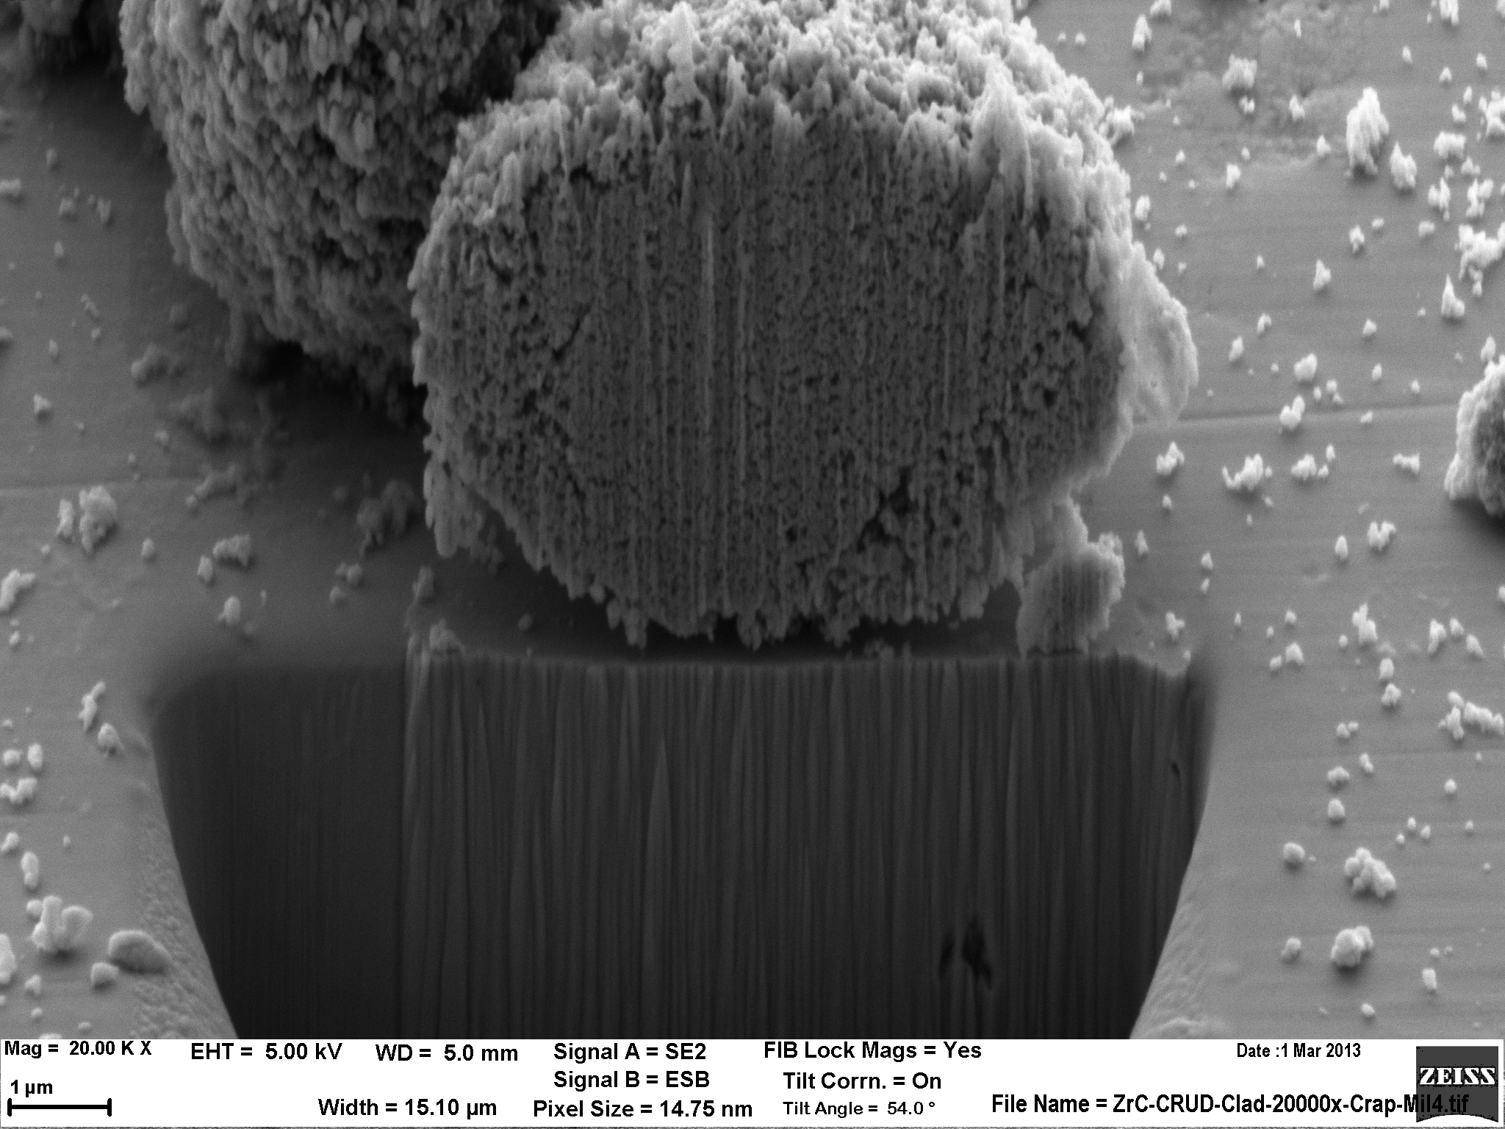
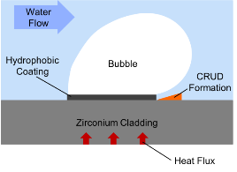
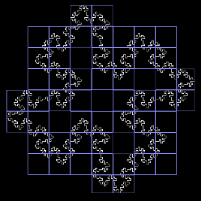
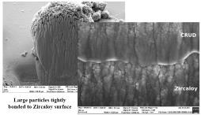
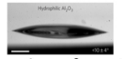
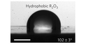
Experimental Goals
CRUD Fractal Analysis
CRUD Mitigation through Control of Boiling
1
CRUD Mitigation through Chemical Bonding
3
2
Fractal analysis using box-counting method with ImageJ program
Determine CRUD’s fractal characteristic in terms of:
tortuosity dimension
area dimension
If CRUD is fractal
Prevent or mitigate CRUD growth through coating that prevent chemical bonding by particles and ions
Pre-screening in small loop
10 materials to be tested
Hydrophobic surface bubble formation could mitigate CRUD
Biphilic surface could control boiling and mitigate CRUD without DNB problem
1
1
1
2
2
2
3
Source: [1] Azimi, G. et. al. “Hydrophobicity of rare-earth oxide ceramics.”

Slide 12

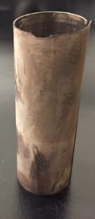
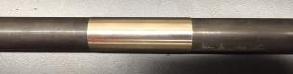

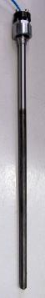
First CRUD Growth after One Week
Sample Ring
Heater
Flow Ring
CRUD grown:
Heater Temperature: 470 Celsius
Water Temperature: 320 Celsius
Pressure:155 bars
7 days

Slide 13
First CRUD Sample: SEM Images
Magnification x7,500
Magnification x3,250

Slide 14
First CRUD Sample: SEM Cross Section
Magnification x25,000
Magnification x10,000

Slide 15
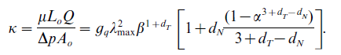
Fractalline Analysis of CRUD
Our CRUD model assumes that CRUD is fractalline, and calculates an effective permeability 𝞳 using this assumption
Requires fractal tortuosity dimension (d_{T}) and fractal area dimension (d_{N}) as shown below:
d_{T} and d_{N} obtained by the box-counting method
ImageJ is used for image processing

Slide 16

Fractal Analysis
Fractal Analysis of First CRUD Sample
Magnification x7500
Magnification x7500 (Binary)

Slide 17
Fractal Analysis
Fractal Area Dimension Analysis of First CRUD Sample
Fractal area dimension d_{N} is 1.8547 which is –slope
d_{N} and d_{T} that was used in Mamba was ~1.6
R² is very close to 1 indicating that CRUD is fractal

Slide 18
One Week of CRUD Growth

Slide 19
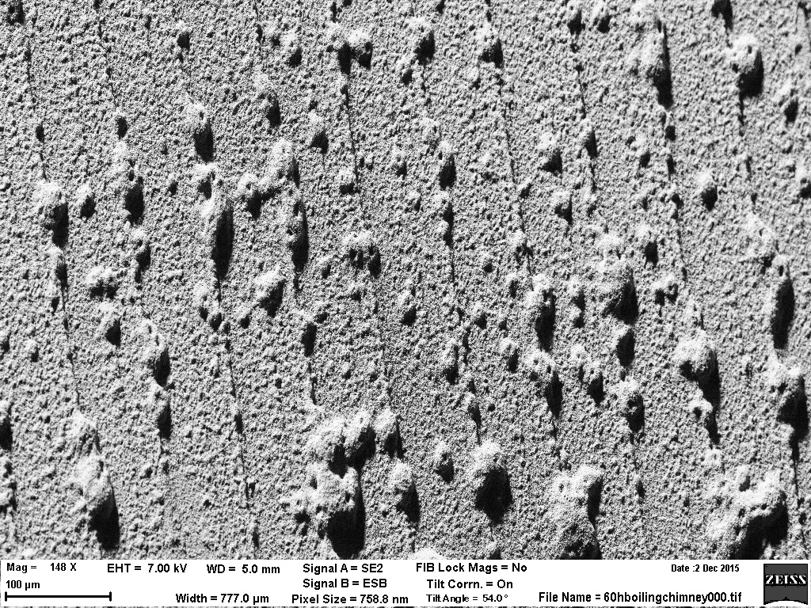
Isolating Boiling Chimneys

Slide 20
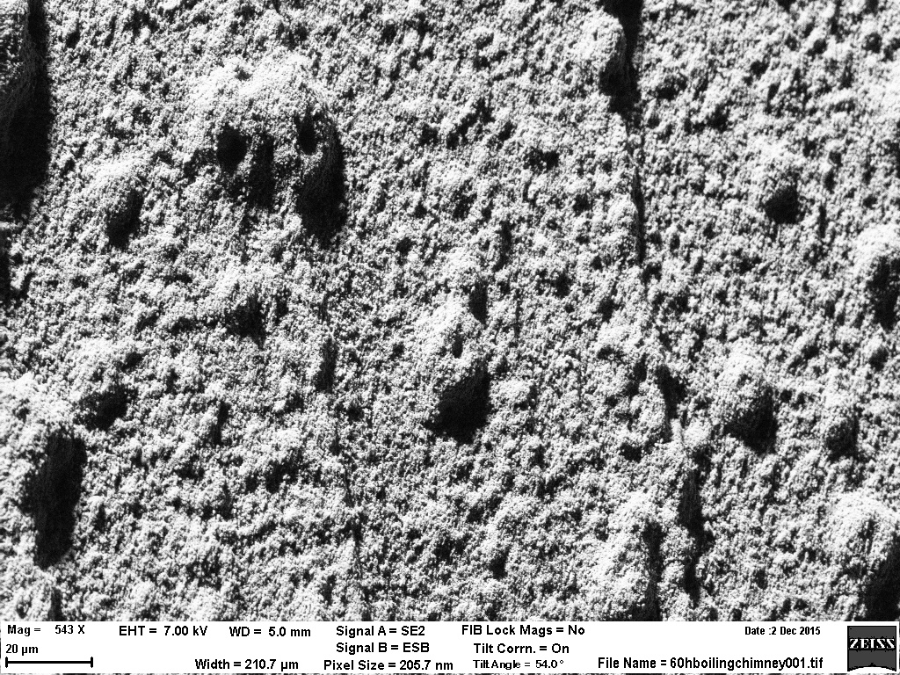
Isolating Boiling Chimneys

Slide 21
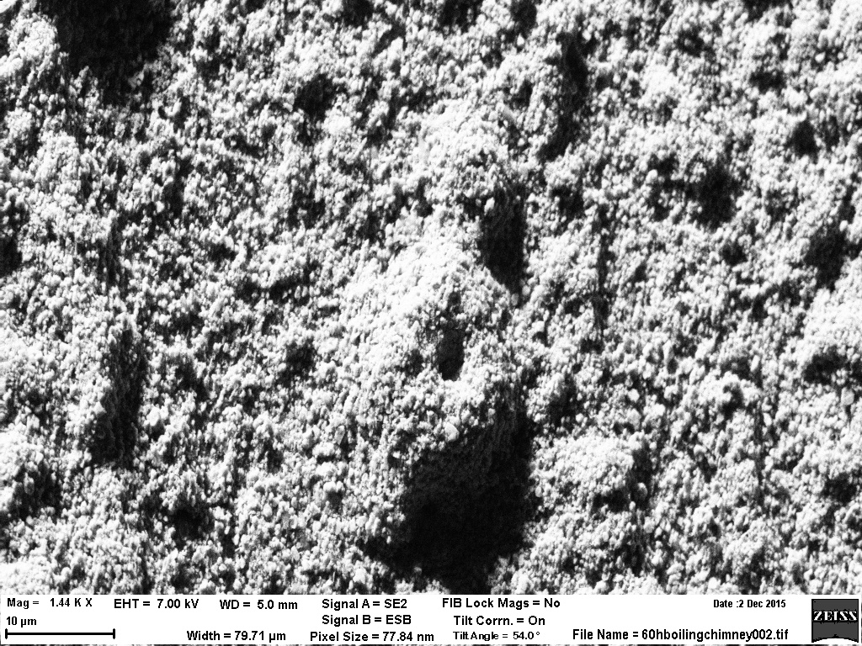
Isolating Boiling Chimneys

Slide 22
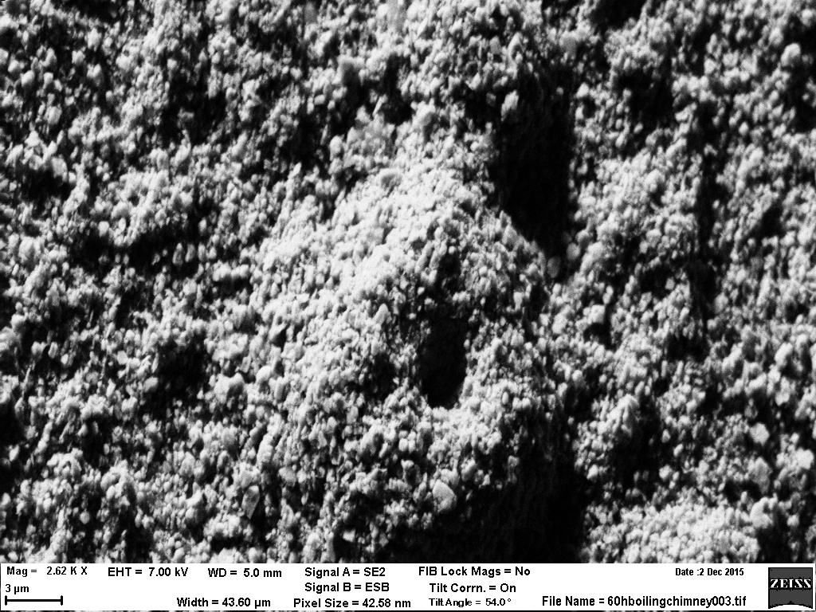
Isolating Boiling Chimneys

Slide 23
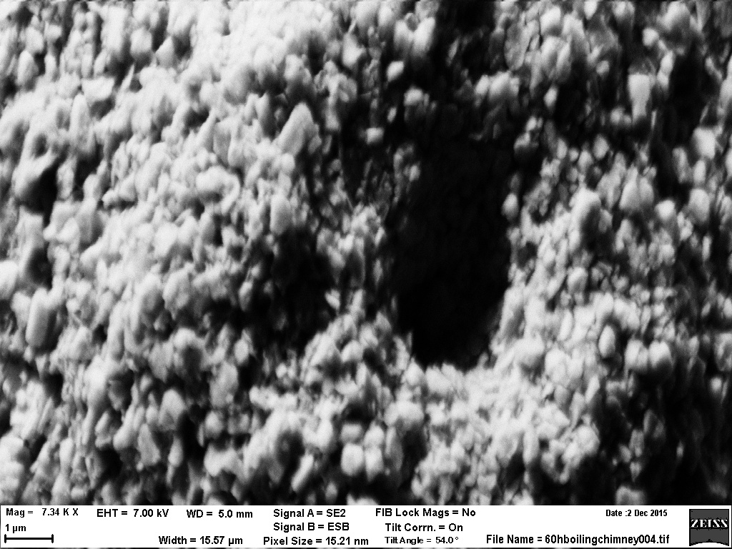
Isolating Boiling Chimneys

Slide 24
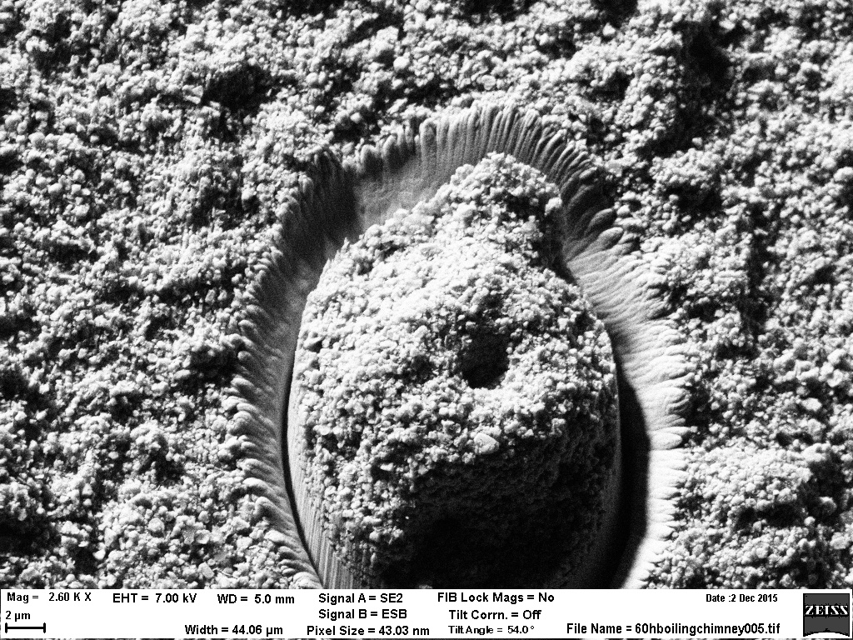
Isolating Boiling Chimneys

Slide 25
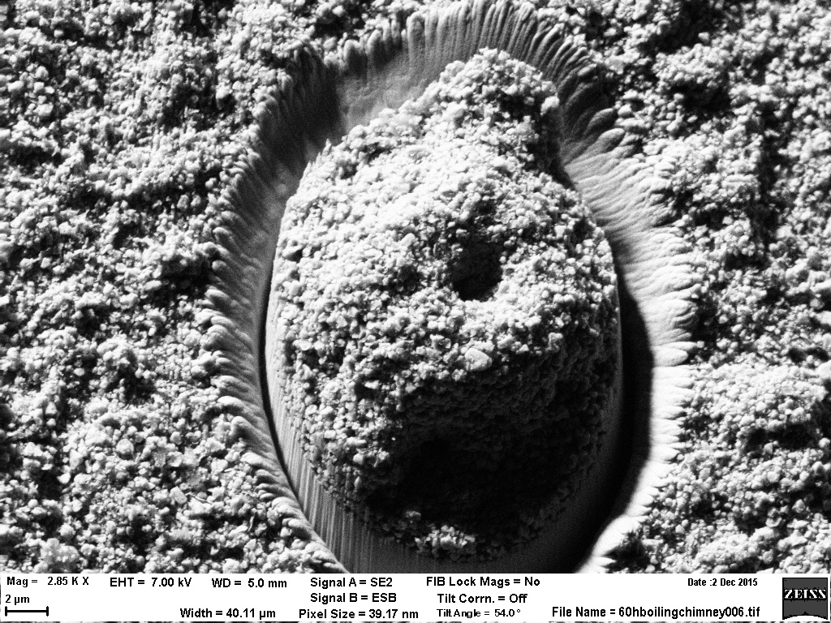
Isolating Boiling Chimneys

Slide 26
Isolating Boiling Chimneys

Slide 27
Starting to Measure Boiling Chimney Properties, Fractalline Dimensions

Slide 28
Images for Fractal Analysis

Slide 29
Ongoing CRUD Characterization – One Week of CRUD Growth, Single Chimney

Slide 30
Ongoing CRUD Characterization – One Week of CRUD Growth, Single Chimney

Slide 31
Going Deep into Boiling Chimneys

Slide 32
Going Deep into Boiling Chimneys

Slide 33
Going Deep into Boiling Chimneys

Slide 34
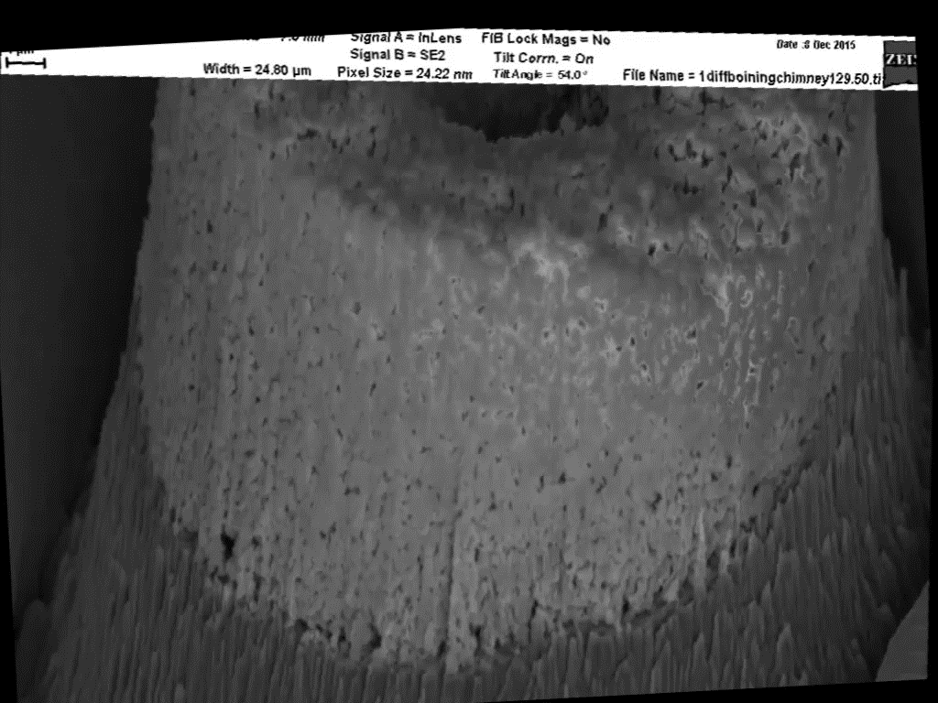
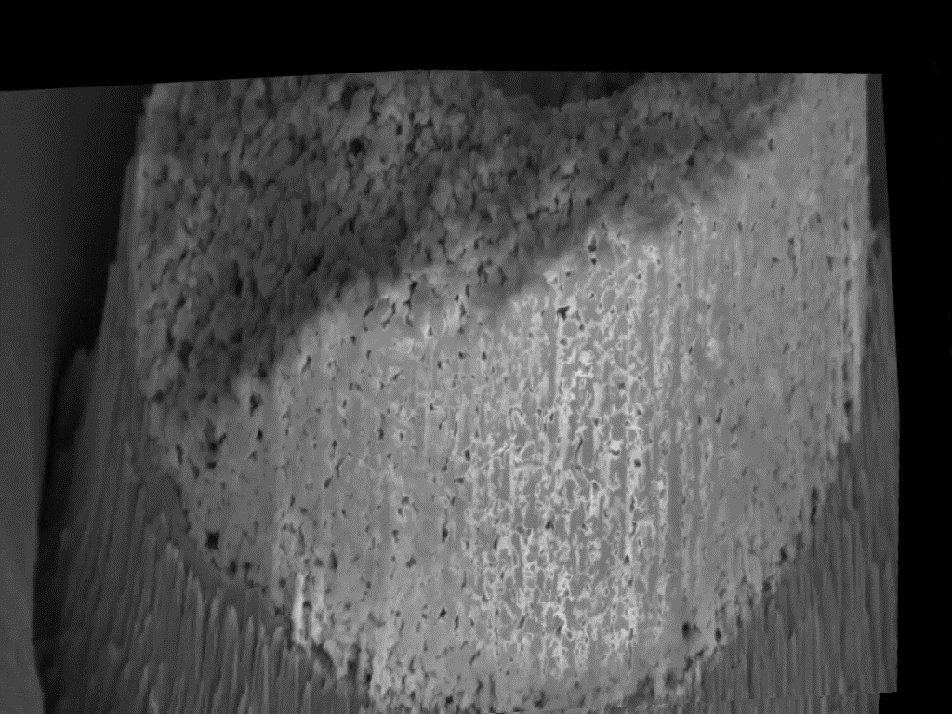
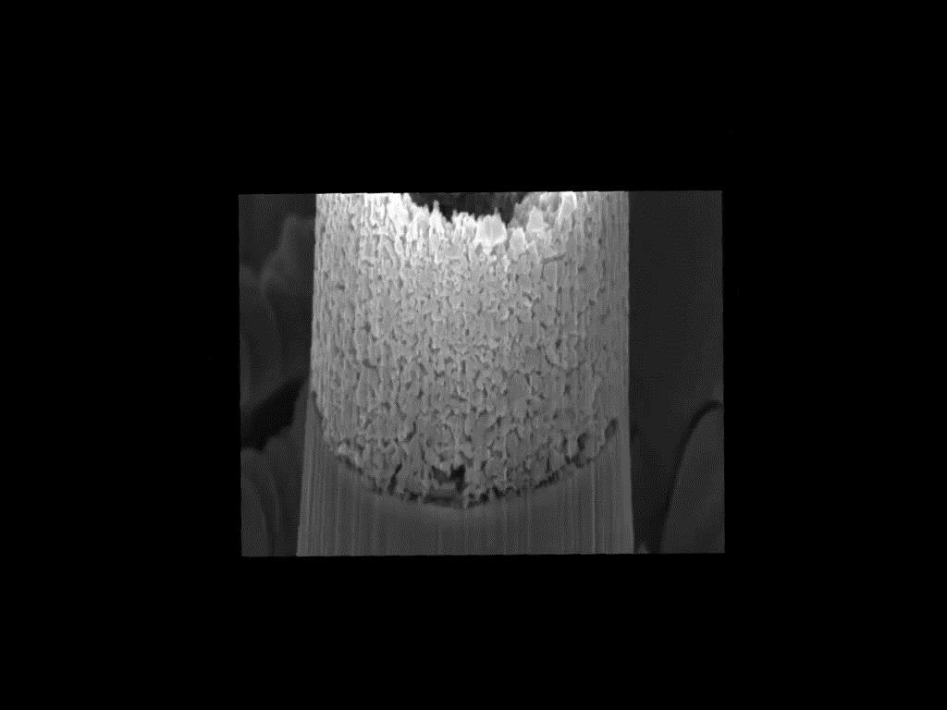
Looking Around Boiling Chimneys

Slide 35
What’s Next in the MIT CRUD Loop?
LOTS more fractal analysis for statistics
Growing CRUD at different pressures (heat fluxes) to control fractal dimensions
Four week CRUD growth experiment ended last week
Development of CRUD resistant materials, biphilic coatings for CRUD mitigation and improved heat transfer

